Slide 1
VOTING WEB APPLICATION WITH DJANGO FRAME WORK

Slide 2
TITLE: Building a Voting Web Application with Django SUBTITLE : Empowering Democracy Through Technology
Slide 1: Introduction
1. Brief overview of the presentation.
2. Importance of voting in a democratic society.
3. Introduction to Django framework.
Slide 2: What is Django?
1.Definition of Django.
2.Key features and benefits.
3.Why Django for web development?

Slide 3
Slide 3: Overview of the Voting App
Description of the voting application.
Goals and objectives.
Importance of user engagement and accessibility.
Slide 4: Technology Stack
Introduction to the technology stack used:
1. Django framework
2. Python programming language
3. HTML/CSS for front-end
4. PostgreSQL for database
Slide 5: Project Setup
Step-by-step guide to setting up the Django project.
Installation of Django and other dependencies.
Creation of Django app for handling voting functionality.

Slide 4
Slide 6: Database Design
Explanation of the database schema.
Models for storing questions, choices, and votes.
Relationships between models.
Slide 7: Views and Templates
Overview of views and templates in Django.
Creation of views to handle user requests.
Designing HTML templates for user interface.
Slide 8: URL Configuration
Explanation of URL patterns in Django.
Mapping URLs to views using URLconf.
Setting up URL routing for the voting app.
Slide 9: User Interaction
Description of user interactions:
Voting on questions
Viewing results
Admin functionalities

Slide 5
Slide 10: Security Measures
1.Importance of security in web applications.
2.Measures taken to secure the voting app:
User authentication
CSRF protection
Input validation
Slide 11: Testing and Debugging
1.Overview of testing methodologies.
2.Unit testing for Django views and models.
3.Debugging techniques for identifying and fixing errors.
Slide 12: Deployment
1.Deployment options for Django applications.
2.Configuration of server environment.
3.Considerations for scaling and maintaining the application.

Slide 6
Slide 13: Future Enhancements
Potential enhancements and features:
Real-time updates using WebSockets
Integration with external authentication services
Mobile responsiveness
Slide 14: Conclusion
Summary of key points covered in the presentation.
Encouragement for further exploration of Django and web development.
Thank you message.

Slide 7
Implementation of the Project Creating Project:
Setting up Django: First, make sure you have Django installed. You can install it using pip:
pip install django
Create a Django project: Start a new Django project using the following command:
django-admin startproject voting_app
Create a Django app: Inside your project directory, create a new Django app for handling the voting functionality:
python manage.py startapp polls

Slide 8
Define models: In your polls app, define your models in models.py. For example, you might have models for Question and Choice.
Create views: Create views to handle user requests. These views will interact with your models and render appropriate templates.
Design templates: Design HTML templates for your application. You can use Django's template language to dynamically generate content.
Configure URLs: Define URL patterns in urls.py files to map URLs to your views.
Handle forms: If your voting application requires user input, create forms using Django's forms framework and handle form submissions in your views.
Apply migrations: After defining your models, run migrations to create database tables:
python manage.py makemigrations
python manage.py migrate

Slide 9
Create superuser: Create a superuser to access the Django admin interface:
python manage.py createsuperuser
Admin interface: Register your models in the Django admin interface (admin.py in your app directory) to manage them easily.
Test your application: Start the development server and test your application in a web browser:
python manage.py runserver
This is a very basic outline to get you started. As you build your application, you may want to explore more advanced features of Django, such as user authentication, permissions, handling of static files, and deployment. The Django documentation is an excellent resource for learning more about these topics.

Slide 10
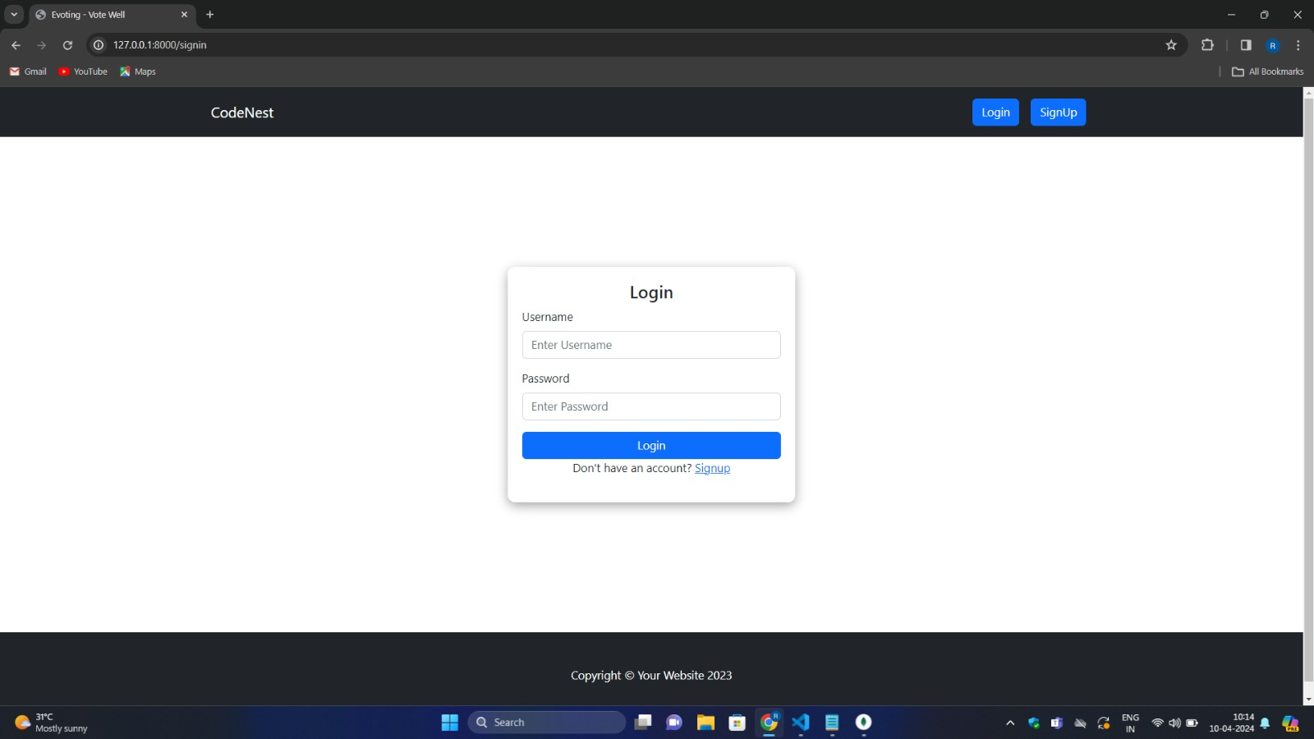
OUTPUT SCREENSHOT:

Slide 11
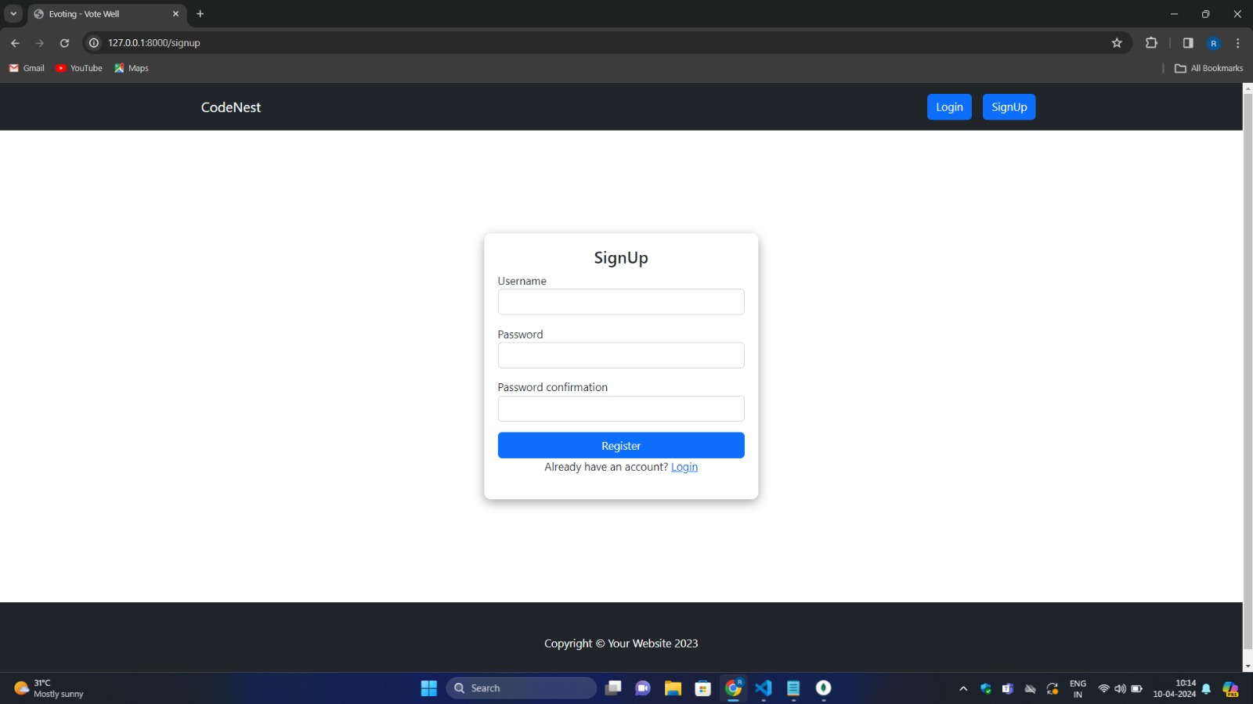

Slide 12
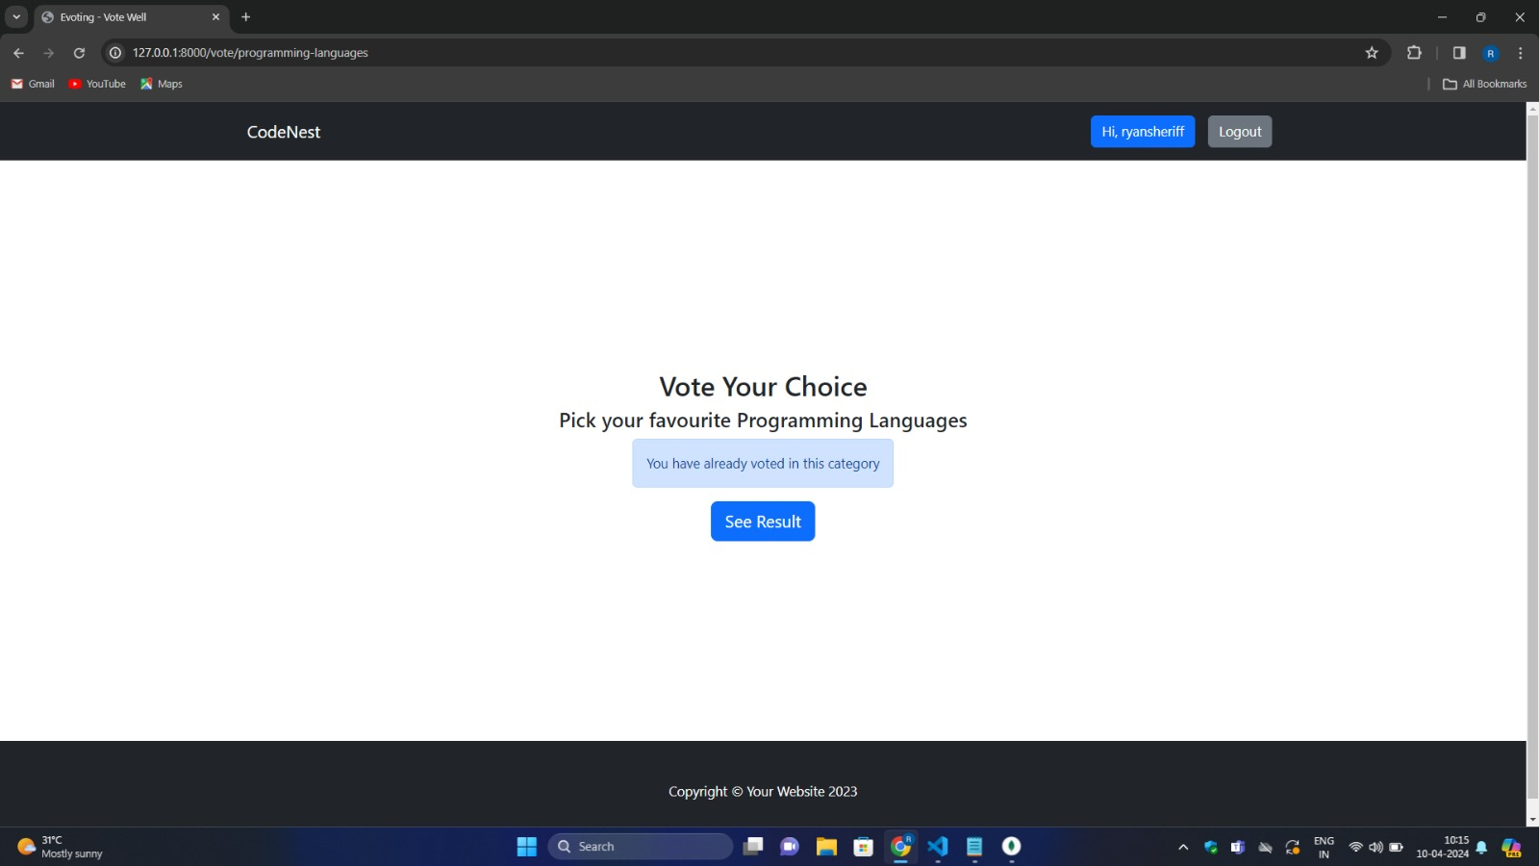

Slide 13
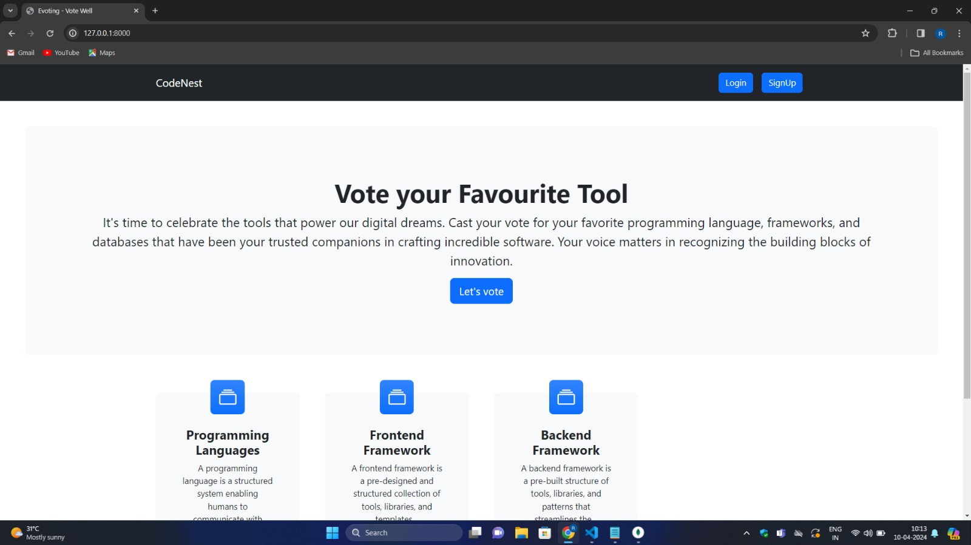

Slide 14
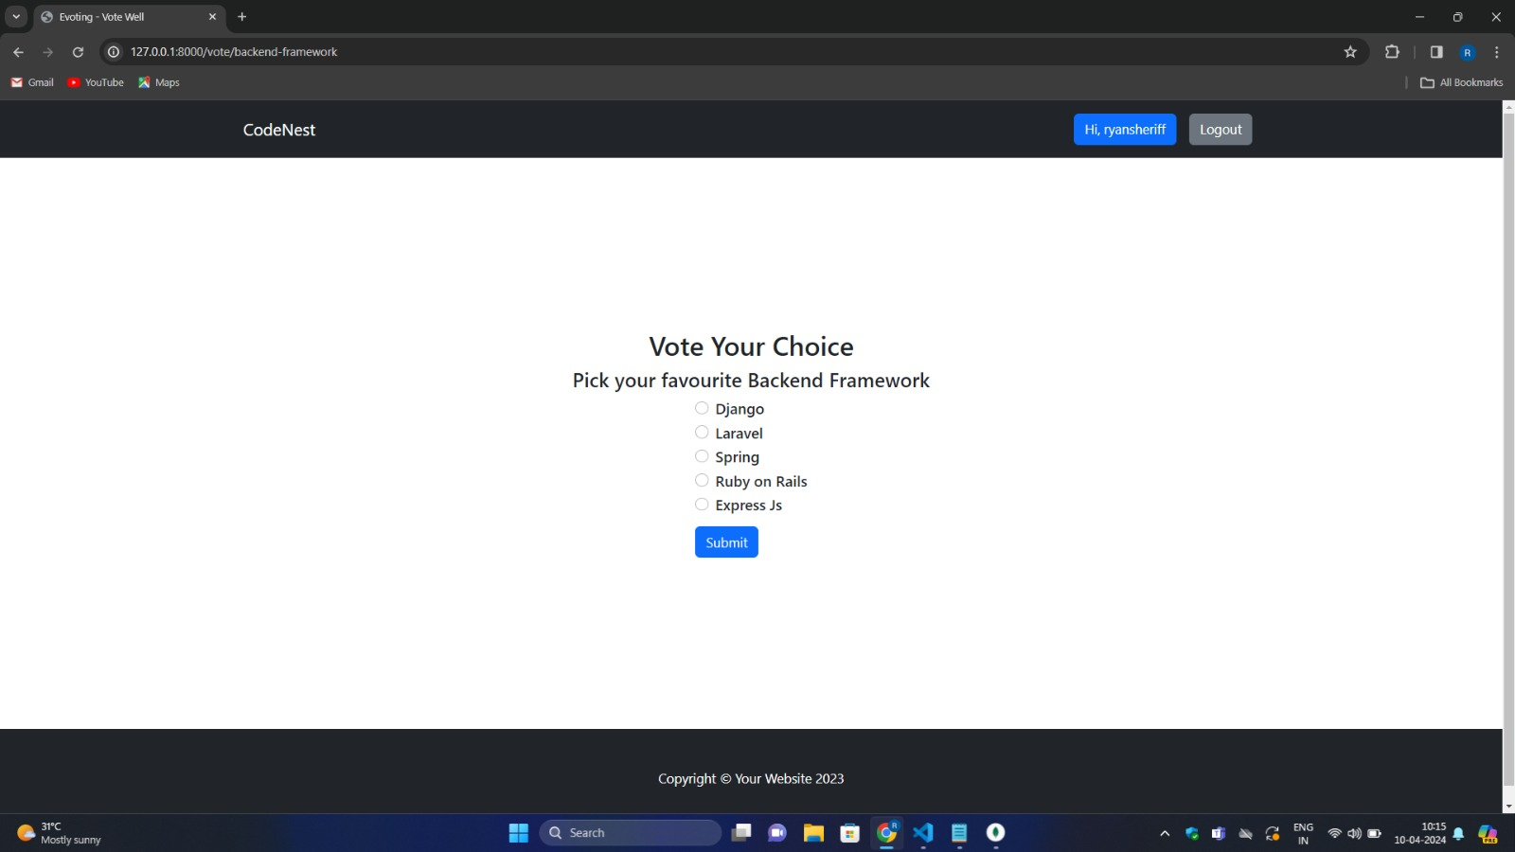

Slide 15
